Slide 1
PROJECT
EMPLOYEE ABSENTEEISM ANALYTICS

Slide 2
PROJECT
EMPLOYEE ABSENTEEISM ANALYTICS

Slide 3
Data Cleaning

Slide 4
Data Cleaning
Age Ends
Duplicate Values
Unknown Cities
Unknown Citites

Slide 5
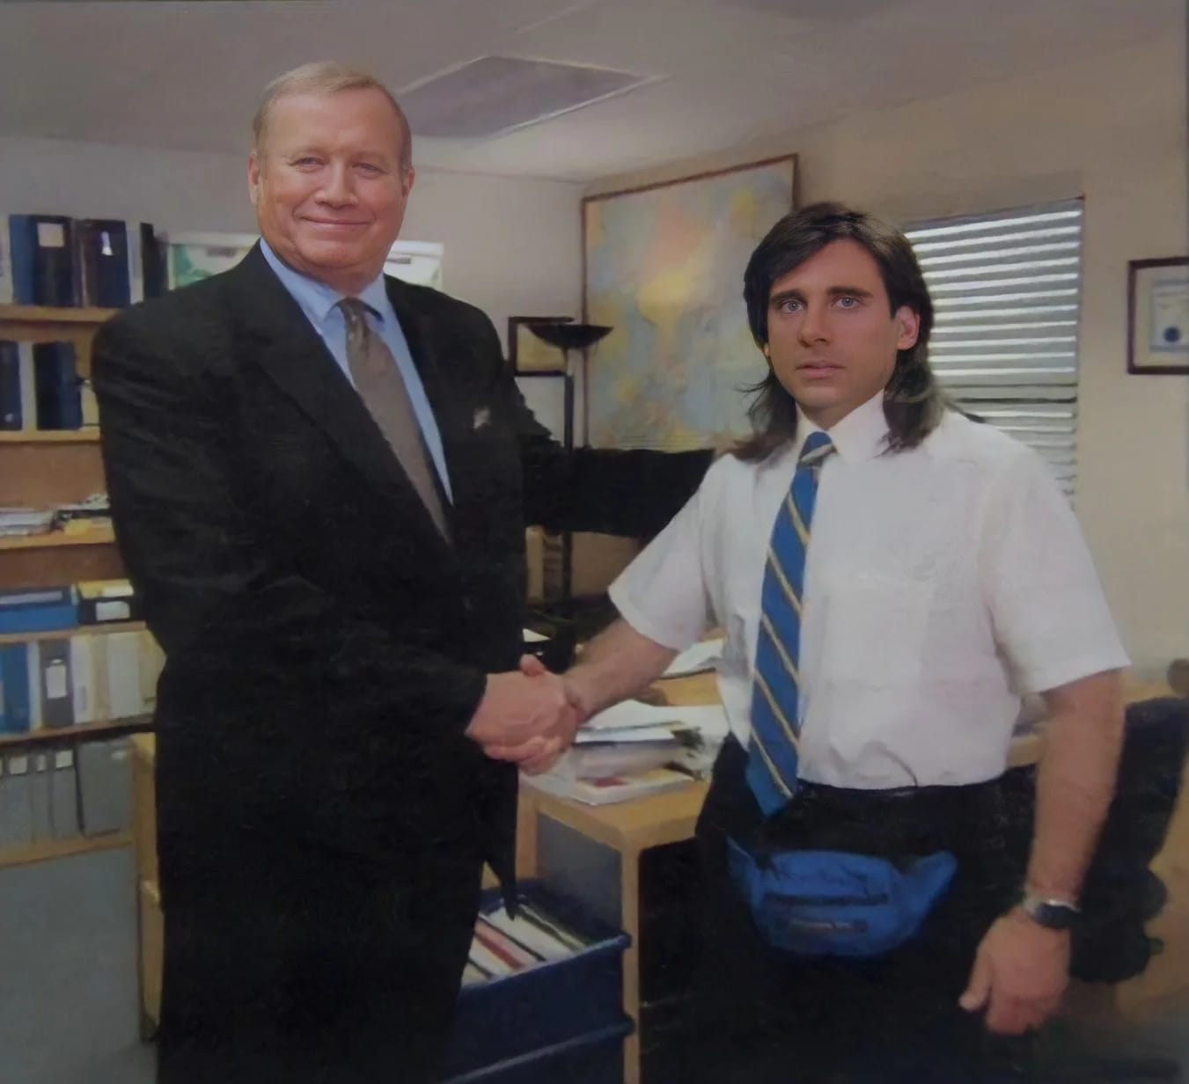
Gender Equality
Random Fictitious Data

Slide 6
PROJECT
EMPLOYEE ABSENTEEISM ANALYTICS

